Slide 1


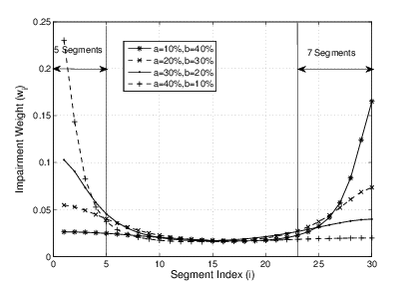


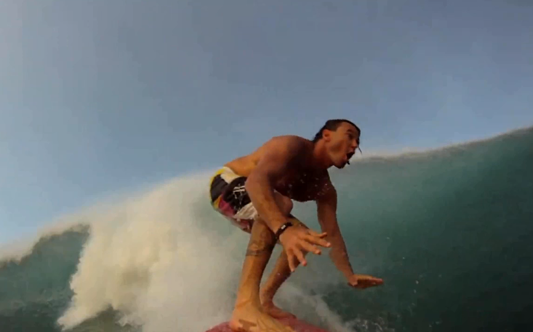
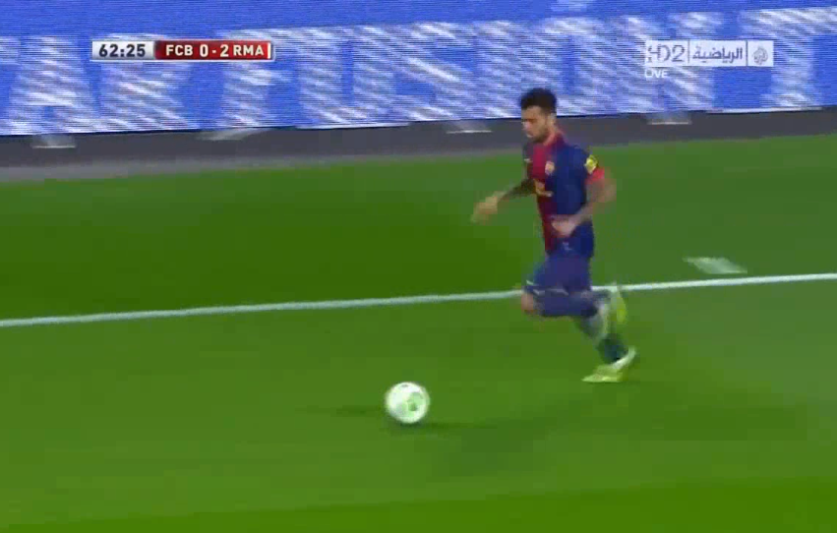
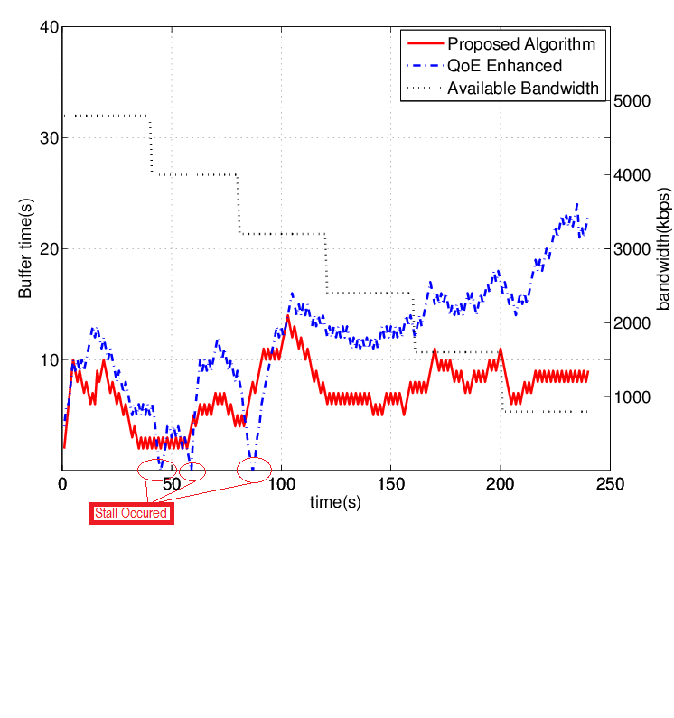
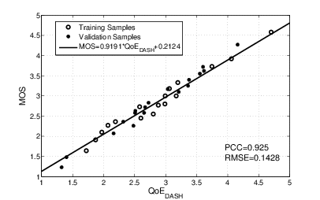


BUPT-QUALCOMM Joint Research Program
User Experience Study on DASH(1)
Liu Yitong, Liu Hao, Shen Yun, Lin Qi, Shen Hui, Li Yuchen
Beijing university of Posts and Telecommunications, China
Email: liuyitong@bupt.edu.cn
Summary
Predict stall
1.Stall probability:
Segment size(bytes) obeys Gaussian Distribution:
$S_{l}(i)\sim N\left(μ,σ\right),μ=b_{l}∗τ;σ=0.2μ$
Stall occurs when
$$B−\frac{S_{l}(i)}{{BW}_{est}}+τ≤0$$
Thus
$P=1−Φ(\frac{S_{d}−μ}{σ})$ with $S_{d}={BW}_{est}\left(B+τ\right)$
2.Stall duration
$$L_{st}= \int_{S_{d}}^{∞}{f\left(x\right)\left(\frac{{TH}_{PB}}{2}+\frac{x}{{BW}_{est}}−B − τ\right)dx}$$
$$f\left(x\right)= \frac{1}{σ\sqrt{2π}}e^{− \frac{{(x−μ)}^{2}}{2σ^{2}}}$$
Study on QoE of DASH
Validate DASH service QoE model
Research 3 impairment factors on DASH service: Initial Delay, Stall, and Level Variation
Test 107 video samples and 64 participants
Propose QoE model in 2 ways: non-linear regression and machine learning
Compare BUPT model with UCSD model provided by Qualcomm
Propose a QoE model of level variation
Identify QoE influence factors via two-way ANOVA analysis
Propose a QoE evaluation model based on Primacy and Recency Effects
Predict stall of DASH service
Research on bitrate adaptation algorithms of DASH
Propose a QoE-based bitrate adaptation algorithm
Propose a bandwidth estimating method for 2 typical scenarios
Research on the performance of bitrate adaptation for multi-user scenario
${BW}_{est}$: estimated bandwidth
$B$: Buffer of client in second
$τ$: duration of one segment
$b_{l}$:bitrate of level l
${TH}_{PB}$:Playback threshold
Bitrate Variation
Impairment on bitrate fluctuation pattern
Background
Primacy and Recency Effects
Videos provided by Qualcomm
Figure 1. Medium Motion Videos (BunnyCartoon and Movie)
Figure 2. High Motion Videos (Sports)
Video | Amount | Motion | Test Factors
BunnyCartoon_Stall_1-11 | 11 | Medium | Stall
Movie_Case01-48 | 48 | Medium | All factors*
Sport_Case01-48 | 48 | High | All factors
All factors*: stall, initial delay, and level variation
Impairment on bitrate switching
R = f(I_{ID}, I_{ST}, I_{LV})
64 participants from BUPT are divided into 3 groups.
Each tester watches about 45 test video clips in one hour.
Frequency bitrate decreased switching causes serious subjective impairment
Impairment due to Initial Delay
Impairment due to Stall
Impairment due to Level Variation
QoE evaluation model for DASH
QoE evaluation functions:
Performance analysis
Stall prediction
Figure 1. Buffer under gradually drop scenario
35 test videos from both simulated environment and real network traces
Two-fold cross validation
Pearson Correlation Coefficient = 0.92
RMSE = 0.14
Our QoE model can reflect user’s experience on DASH accurately
[1] Dongeun Suh et al, "QoE-enhanced Adaptation Algorithm over DASH for Multimedia Streaming" 2014

Slide 2
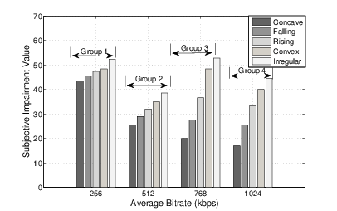
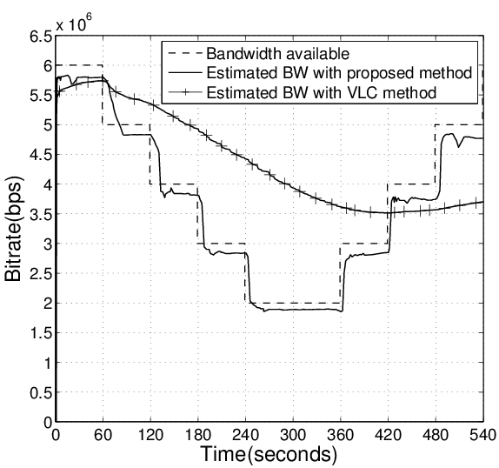
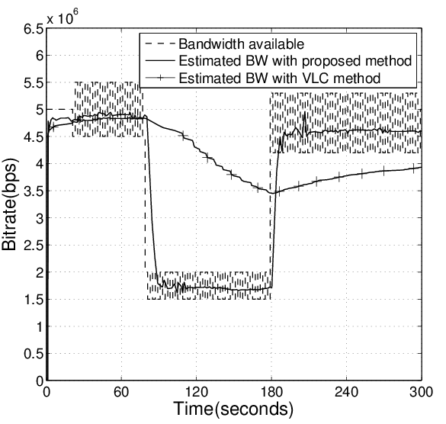
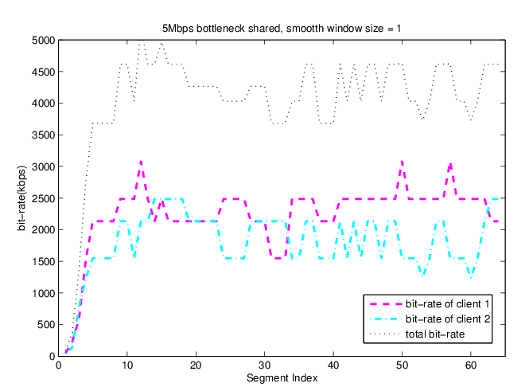
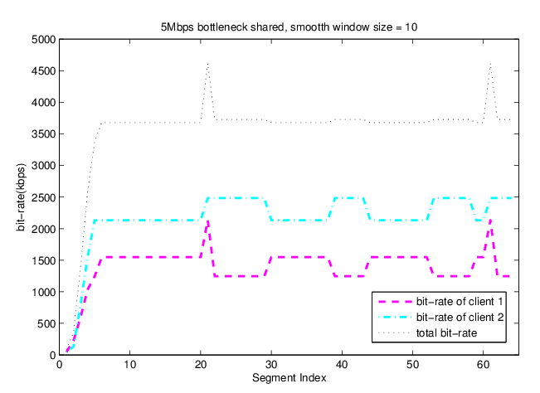
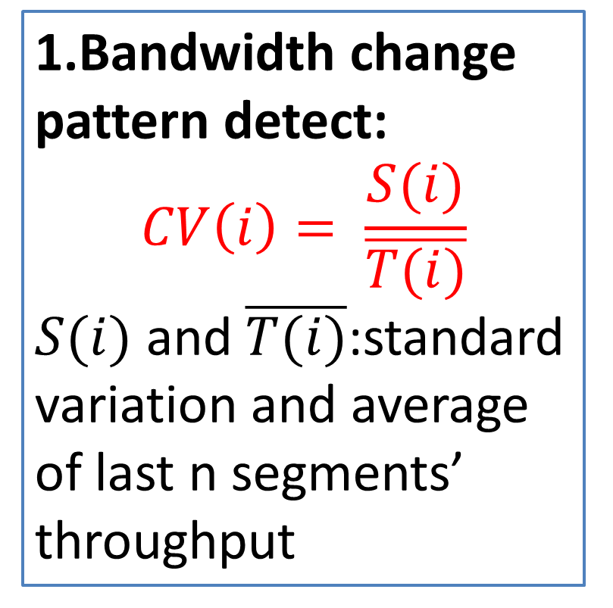
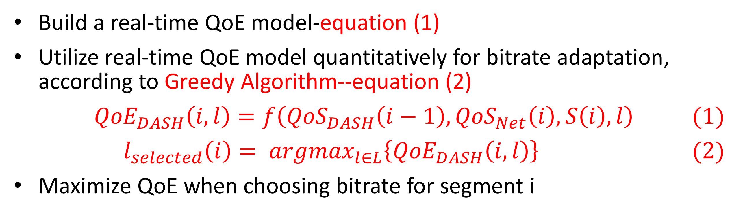

BUPT-QUALCOMM Joint Research Program
User Experience Study on DASH(2)
Liu Yitong, Liu Hao, Shen Yun, Lin Qi, Shen Hui, Li Yuchen
Beijing university of Posts and Telecommunications, China
Email: liuyitong@bupt.edu.cn
Subjective Impairment Tests
Bandwidth Variation Scenario | QoE Scores (using UCSD)
 | Proposed Algorithm | Compared Algorithm^{[1]} | Overall Optimization
Fluctuation | 3.7419 | 3.5773 | 3.7705
Gradually drop | 3.8380 | 3.3778 | 3.8405
Dramatically drop | 3.9492 | 3.7343 | 3.9506
Subjective impairment tests under simulated environment
Influence factors:
Average bitrate
Bitrate fluctuation patterns:
Concave, Falling, Convex
Irregular: bitrate switches frequently with huge amplitude
Bitrate switching frequency
Bandwidth estimation
Estimate bandwidth for 2 typical scenario
Long-term variation within wide range—response quickly
Short-term fluctuation within narrow band—keep stable
Test Impairment Factors on DASH Service
1.Bandwidth change pattern detect:
$$CV\left(i\right)= \frac{S(i)}{\overline{T(i)}}$$
$S(i)$ and $\overline{T(i)}$:standard variation and average of last n segments’ throughput
Polynomial Model
Performance of BUPT Model
Performance Validation of UCSD Model
2.Bandwidth estimate:
$${BW}_{e}\left(i\right)= \sum_{j=i−n−1}^{i−1}{ω\left(j\right)T(j)}$$
$$ω\left(k\right)=\left\{\begin{aligned}\frac{e^{k}}{\sum_{i=1}^{n}{e^{i}}} if CV\left(i\right)>0.1 \\ \frac{1}{n} others\end{aligned}\right.$$
$$k=j−\left(i−n−1\right)+1$$
Figure 2. Bandwidth estimation for scenario 1
PCC : 0.8719, MSE : 0.0961
Performance is improved, even better in low motion scenario.
Result of UCSD Model
(Provided by UCSD)
PCC : 0.91
MSE : 0.082
Our Validation Result of UCSD Model
PCC : 0.7811
MSE : 0.1821
Machine Learning Model
≤12.5
>12.5
Machine Learning Model
Train M5P and Regression Tree.
Regression Tree Model:
≤16.5
>16.5
≤25.5
>25.5
Figure 3. Bandwidth estimation for scenario 2
≤16.5
>25.5
Research on multi-user scenario
Simulate two-users condition
Compare several bitrate adaptation algorithms
When bitrate adaptation is smoother , fairness and efficiency are less
QoE based bit-rate adaptation
Build a real-time QoE model-equation (1)
Utilize real-time QoE model quantitatively for bitrate adaptation, according to Greedy Algorithm--equation (2)
$${QoE}_{DASH}\left(i,l\right)=f\left({QoS}_{DASH}\left(i−1\right),{QoS}_{Net}\left(i\right),S\left(i\right),l\right) (1)$$
$$l_{selected}\left(i\right)= {argmax}_{l∈L}\left\{{QoE}_{DASH}\left(i,l\right)\right\} (2)$$
Maximize QoE when choosing bitrate for segment i
Analysis performance
1.Use UCSD DASH QoE model for simulation
2.Compare with algorithm utilizing QoE model qualitatively
3.Deduce overall optimization with provided bandwidth variation
4.Calculate QoE with the given model
Figure 4. User = 2, smooth window size = 1
Unfairness = 545.9; Utilization = 0.819
Figure 5. User = 2, smooth window size = 15
Unfairness = 784.3; Utilization = 0.712
Table 1. QoE Comparison

Slide 3
BUPT-QUALCOMM Joint Research Program
Study on DASH QoE Evaluation
Liu Hao, Shen Yun, Liu Yitong
Wireless Theories and Technologies Lab
Beijing university of Posts and Telecommunications, China
Email: liuyitong@bupt.edu.cn
Summary
Performance analysis
Performance of BUPT Model
Performance Validation of UCSD Model
Build BUPT QoE model of DASH service
Research 3 impairment factors on DASH service: Initial Delay, Stall, and Level Variation
107 video samples and 64 participants, more than 2800 votes received
Validate UCSD QoE model with BUPT subjective test results
More accurate than UCSD model with results both from BUPT and UCSD/Qualcomm
Propose a QoE model of level variation
Based on Primacy and Recency Effects
Identify level variation influence factors: Bitrate Switching, Bitrate Fluctuation Pattern
PCC : 0.9251 MSE : 0.0536
Performance is improved, even better in low motion scenario.
Result of UCSD Model
(Provided by UCSD)
PCC : 0.91
MSE : 0.082
Our Validation Result of UCSD Model
PCC : 0.7811
MSE : 0.1821
Subjective Impairment Tests
Subjective impairment tests under simulated environment
User Experience Impairment Factors
Influence factors:
Average bitrate
Bitrate fluctuation patterns:
Concave, Falling, Convex
Irregular: bitrate switches frequently with huge amplitude
Bitrate switching frequency
Videos provided by Qualcomm
Medium Motion Videos (BunnyCartoon and Movie)
High Motion Videos (Sports)
Impairment on bitrate fluctuation pattern
Video | Amount | Motion | Test Factors
BunnyCartoon_Stall_1-11 | 11 | Medium | Stall
Movie_Case01-48 | 48 | Medium | All factors*
Sport_Case01-48 | 48 | High | All factors
Primacy and Recency Effects
All factors*: stall, initial delay, and level variation
R = f(I_{ID}, I_{ST}, I_{LV})
Test 107 video samples and 64 participants
More than 2800 votes are received
Evaluation methodology: Single-Stimulus (SS)
Impairment due to Initial Delay
Impairment due to Stall
Impairment due to Level Variation
Impairment on bitrate switching
Frequency bitrate decreased switching causes serious subjective impairment
Variation | R | I_{ID} | I_{ST} | I_{LV}
R | —
I_{ID} | 0.234 | —
I_{ST} | 0.001 | 0.327 | —
I_{LV} | 0.000 | 0.927 | 0.946 | —
Impairments of Stall and Level Variation is more serious than Initial Delay.(1st row)
Initial Delay is nearly independent with Stall and Level Variation. (2nd and 3rd row)
Initial Delay and Stall Duration follow linear relation with QoE
QoE evaluation model for DASH
QoE evaluation functions
*Strong correlation when value <0.05
Performance analysis
35 test videos from both simulated environment and real network traces
Two-fold cross validation
Pearson Correlation Coefficient = 0.92
RMSE = 0.14
Our QoE model can reflect user’s experience on DASH accurately
QoE model in DASH Service
UCSD Model
BUPT Model

Slide 4
BUPT-QUALCOMM Joint Research Program
DASH User Experience Improvement Study
Lin Qi, Shen Hui, Li Yuchen, and Liu Yitong
Beijing university of Posts and Telecommunications, China
Email: liuyitong@bupt.edu.cn
Summary
Validate DASH service QoE model
Research 3 impairment factors on DASH service: Initial Delay, Stall, and Level Variation
Test 107 video samples and 64 participants
Propose QoE model in 2 ways: non-linear regression and machine learning
Compare BUPT model with UCSD model provided by Qualcomm
Propose a QoE model of level variation
Identify QoE influence factors via two-way ANOVA analysis
Propose a QoE evaluation model based on Primacy and Recency Effects
Predict stall of DASH service
Bandwidth estimation
Estimate bandwidth for 2 typical scenario
Long-term variation within wide range—response quickly
Short-term fluctuation within narrow band—keep stable
1.Bandwidth change pattern detect:
$$CV\left(i\right)= \frac{S(i)}{\overline{T(i)}}$$
$S(i)$ and $\overline{T(i)}$:standard variation and average of last n segments’ throughput
2.Bandwidth estimate:
$${BW}_{e}\left(i\right)= \sum_{j=i−n−1}^{i−1}{ω\left(j\right)T(j)}$$
$$ω\left(k\right)=\left\{\begin{aligned}\frac{e^{k}}{\sum_{i=1}^{n}{e^{i}}} if CV\left(i\right)>0.1 \\ \frac{1}{n} others\end{aligned}\right.$$
$$k=j−\left(i−n−1\right)+1$$
Figure 2. Bandwidth estimation for scenario 1
Figure 3. Bandwidth estimation for scenario 2
Research on multi-user scenario
Simulate two-users condition
Compare several bitrate adaptation algorithms
When bitrate adaptation is smoother , fairness and efficiency are less
Figure 4. User = 2, smooth window size = 1
Unfairness = 545.9; Utilization = 0.819
Figure 5. User = 2, smooth window size = 15
Unfairness = 784.3; Utilization = 0.712
Table 1. QoE Comparison

Slide 5



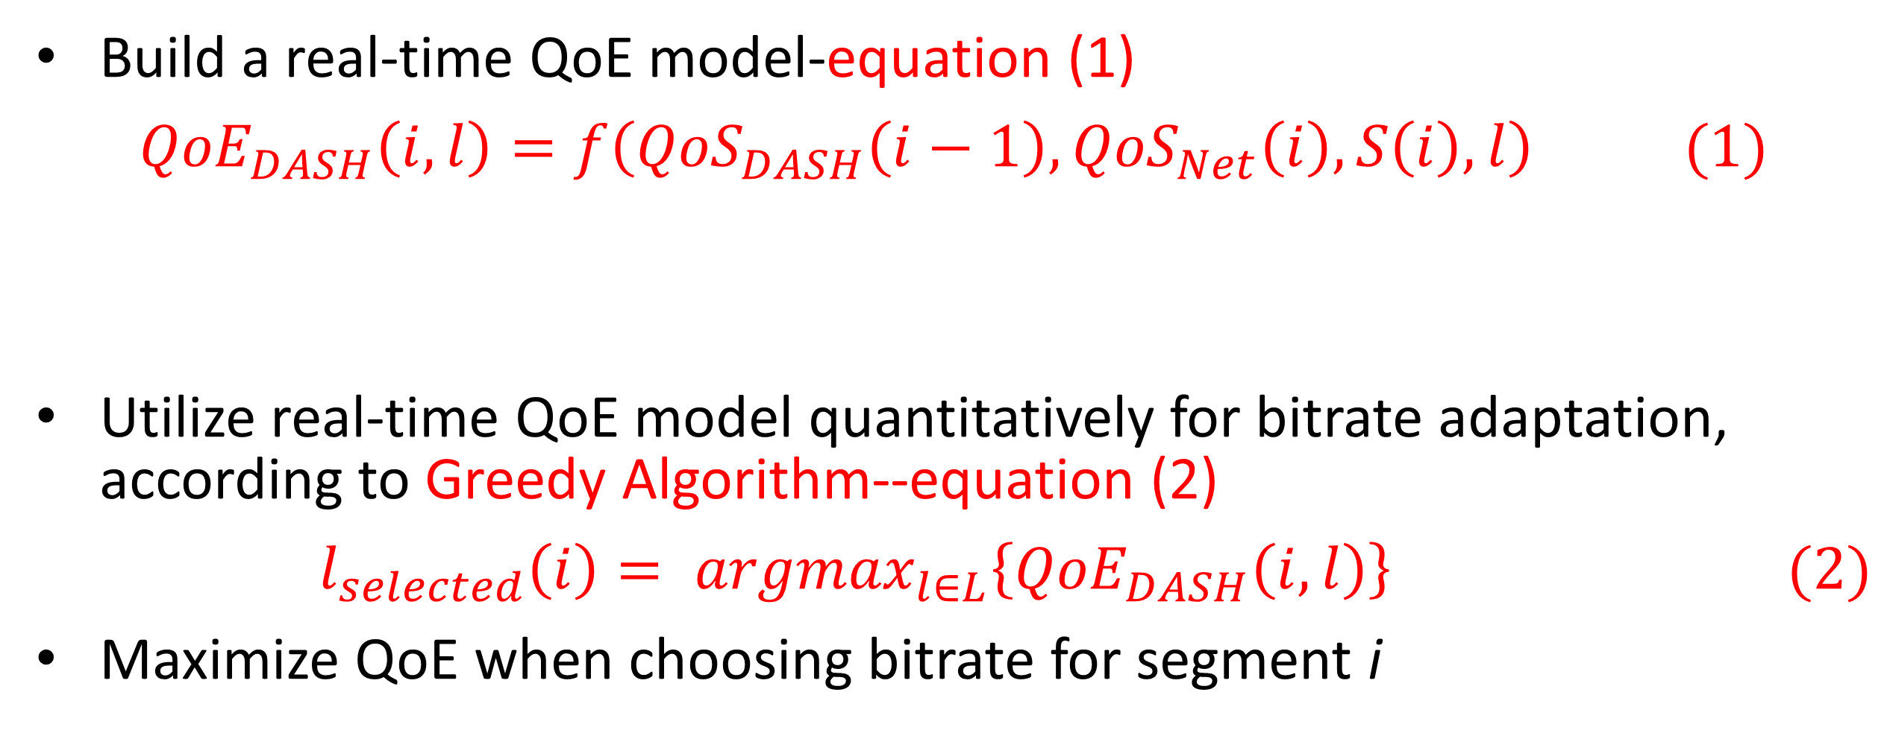

BUPT-QUALCOMM Joint Research Program
Rate Adaptation Algorithms for Dynamic Adaptive Streaming over HTTP
Lin Qi, Shen Hui, and Liu Yitong
Beijing University of Posts and Telecommunications, China
Email: shenhui0509@bupt.edu.cn
Summary
Predict stall
1.Stall probability:
Segment size(bytes) obeys Gaussian Distribution:
$S_{l}(i)\sim N\left(μ,σ\right),μ=b_{l}∗τ;σ=0.2μ$
Stall occurs when
$$B−\frac{S_{l}(i)}{{BW}_{est}}+τ≤0$$
Thus
$P=1−Φ(\frac{S_{d}−μ}{σ})$ with $S_{d}={BW}_{est}\left(B+τ\right)$
2.Stall duration
$$L_{st}= \int_{S_{d}}^{∞}{f\left(x\right)\left(\frac{{TH}_{PB}}{2}+\frac{x}{{BW}_{est}}−B − τ\right)dx}$$
$$f\left(x\right)= \frac{1}{σ\sqrt{2π}}e^{− \frac{{(x−μ)}^{2}}{2σ^{2}}}$$
Propose a QoE based bitrate adaptation algorithm
Propose a bandwidth estimation algorithm for 2 typical scenarios
Research on the bitrate adaptation performance for multi-user scenario
${BW}_{est}$: estimated bandwidth
$B$: Buffer of client in second
$τ$: duration of one segment
$b_{l}$:bitrate of level l
${TH}_{PB}$:Playback threshold
QoE based bit-rate adaptation
Build a real-time QoE model-equation (1)
$${QoE}_{DASH}\left(i,l\right)=f\left({QoS}_{DASH}\left(i−1\right),{QoS}_{Net}\left(i\right),S\left(i\right),l\right) (1)$$
Utilize real-time QoE model quantitatively for bitrate adaptation, according to Greedy Algorithm--equation (2)
$$l_{selected}\left(i\right)= {argmax}_{l∈L}\left\{{QoE}_{DASH}\left(i,l\right)\right\} (2)$$
Maximize QoE when choosing bitrate for segment i
${QoS}_{DASH}$: includes stall , initial delay and level variation. Details in another poster.
$S\left(i\right)$:State of client before sending request of segment i, mainly buffer length
Bandwidth estimation
Analyze performance
1.Propose a stall prediction method
2.Adopt UCSD DASH QoE model for simulation
3.Compare with algorithm utilizing QoE model qualitatively^{[1]}
4.Compare with overall optimization results deduced from provided bandwidth variation
Estimate bandwidth for 2 typical scenario
Long-term variation within wide range—response quickly
Short-term fluctuation within narrow band—keep stable
Table 1. QoE Comparison
Bandwidth Variation Scenario | QoE Scores
 | Proposed Algorithm | Compared Algorithm^{[1]} | Overall Optimization
Fluctuation | 3.7419 | 3.5773 | 3.7705
Gradually drop | 3.8380 | 3.3778 | 3.8405
Dramatically drop | 3.9492 | 3.7343 | 3.9506
Figure 2. Bandwidth estimation for scenario 1
Figure 3. Bandwidth estimation for scenario 2
1.Bandwidth change pattern detect:
$$CV\left(i\right)= \frac{S(i)}{\overline{T(i)}}$$
$S(i)$ and $\overline{T(i)}$:standard variation and average of last n segments’ throughput
2.Bandwidth estimate:
$${BW}_{e}\left(i\right)= \sum_{j=i−n−1}^{i−1}{ω\left(j\right)T(j)}$$
$$ω\left(k\right)=\left\{\begin{aligned}\frac{e^{k}}{\sum_{i=1}^{n}{e^{i}}} if CV\left(i\right)>0.1 \\ \frac{1}{n} others\end{aligned}\right.$$
$$k=j−\left(i−n−1\right)+1$$
[1] Dongeun Suh et al, "QoE-enhanced Adaptation Algorithm over DASH for Multimedia Streaming" 2014
Future work
Network-assisted DASH
Involve network device into adaptation
Resource allocation for multi-user
Figure 1. Buffer under gradually drop scenario
Research on multi-user scenario
Simulate two-users condition
Compare several bitrate adaptation algorithms
When bitrate adaptation is smoother , fairness and efficiency are less
Note :Smooth window size: The number of segments involved in bandwidth estimation
Figure 4. User = 2, smooth window size = 1
Unfairness = 545.9; Utilization = 0.819
Figure 5. User = 2, smooth window size = 15
Unfairness = 784.3; Utilization = 0.712

Slide 6


DASH User Experience Improvement
QoE Model of Level Variation
Primacy and Recency Effects
QoE evaluation functions:
Bandwidth Estimation
Estimate bandwidth for two typical scenario
Long-term variation within wide range
Short-term fluctuation within narrow band
1.Bandwidth change pattern detect:
$$CV\left(i\right)= \frac{S(i)}{\overline{T(i)}}$$
$S(i)$ and $\overline{T(i)}$:standard variation and average of last n segments’ throughput
Figure 2. Bandwidth estimation for scenario 1
2.Bandwidth estimate:
$${BW}_{e}\left(i\right)= \sum_{j=i−n−1}^{i−1}{ω\left(j\right)T(j)}$$
$$ω\left(k\right)=\left\{\begin{aligned}\frac{e^{k}}{\sum_{i=1}^{n}{e^{i}}} if CV\left(i\right)>0.1 \\ \frac{1}{n} others\end{aligned}\right.$$
$$k=j−\left(i−n−1\right)+1$$
Figure 3. Bandwidth estimation for scenario 2

